Slide 1
Wikipedia for Schools
A Digital Approach to Education By Limoke Oscar

Slide 2
Wikipedia for Schools Why??
Increased school computer labs
More and more technology around students
Too much information available
Students more informed than teachers?
Changing communication trends
Teacher-student/Parent-child relationships changed

Slide 3
Overview
Provide content for free
Increase knowledge thirst
Quench the knowledge thirst

Slide 4
The whole purpose of education is to turn mirrors into windows
Wikipedia for Schools
Herbert Spencer (1820 - 1903)

Slide 5
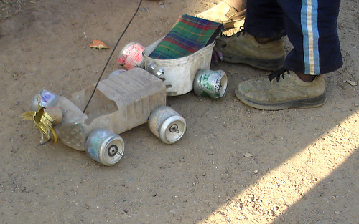
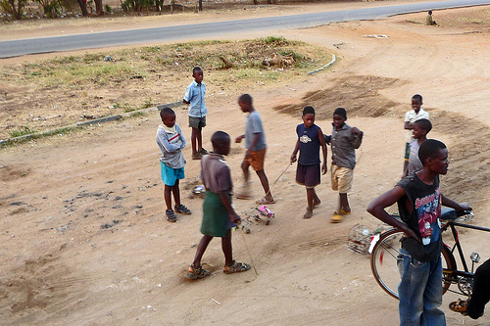
Wikipedia for Schools

Slide 6
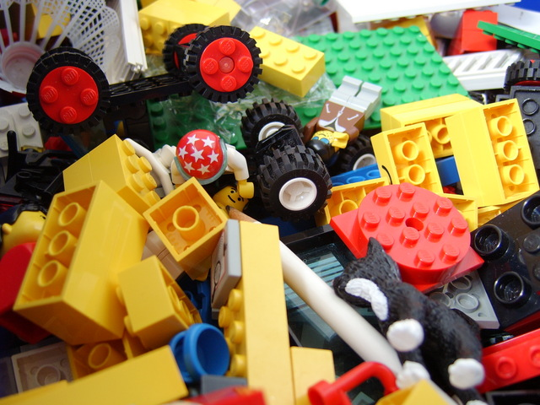
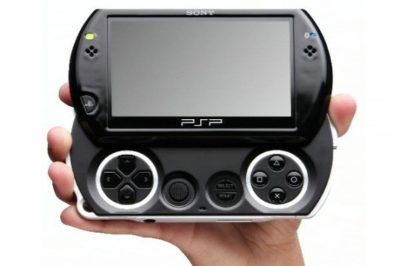
Wikipedia for Schools

Slide 7
Wikipedia for Schools

Slide 8
If we teach today as we taught yesterday, we rob our children their tomorrow
Wikipedia for Schools
John Dewey

Slide 9
3,527,588 Articles in English
21,000+ in Swahili
Anyone can edit, submit
Free to copy and re-use

Slide 10
How?
Get information on schools with computers
Install offline version of Wikipedia (Education Edition)
Train teachers
Workshops for students
Follow up and updates on the installations
Get feedback and more follow up trainings

Slide 11
Needs?

Slide 12
Who?
Wikimedia Kenya
Students/Volunteers
Wikimedia Foundation
Ministry of Education
Civil Society – NGOs, CBOs
Other stakeholders in Education
Corporates

Slide 13
BTW…

Slide 14
Wikileaks is not associated with Wikipedia or Wikimedia…….
…spread the word!!

