Slide 1
8 March 2011 and 12 Dec. 2011
Sudden increase in numbers on Wikipedia

Slide 2
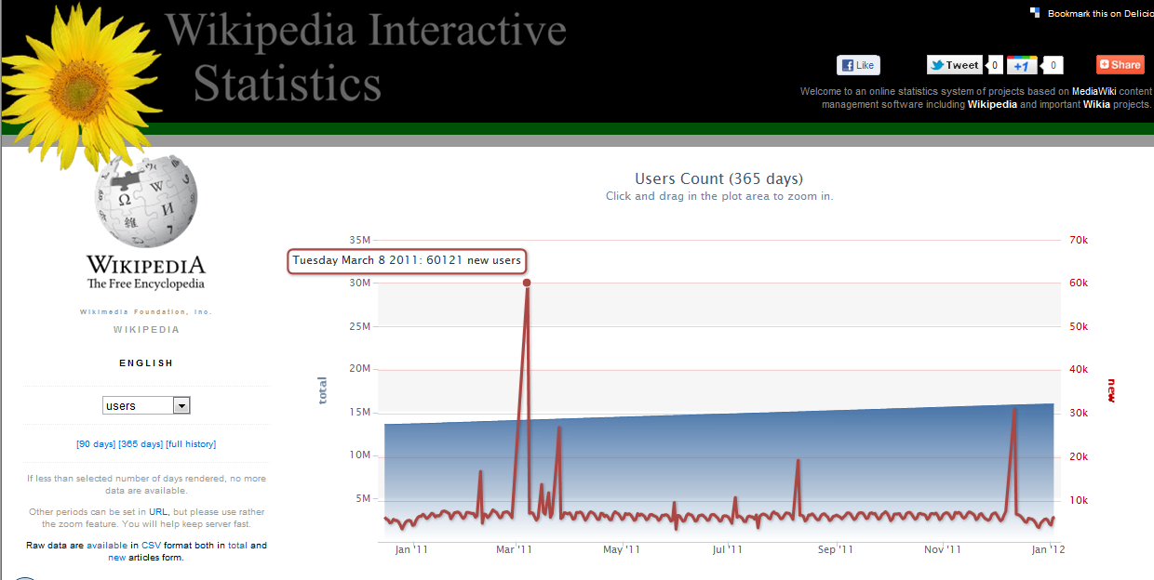

Slide 3
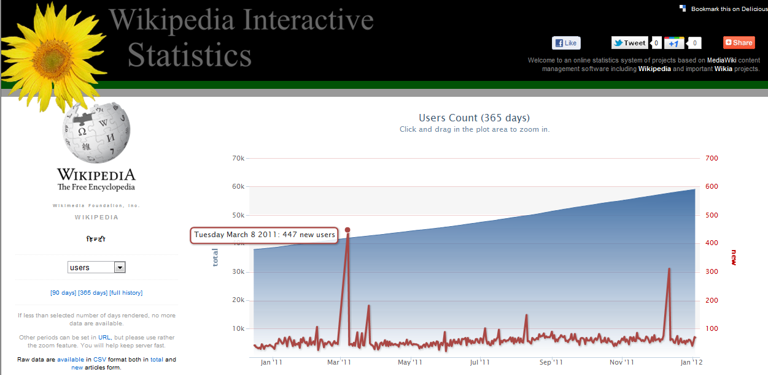

Slide 4
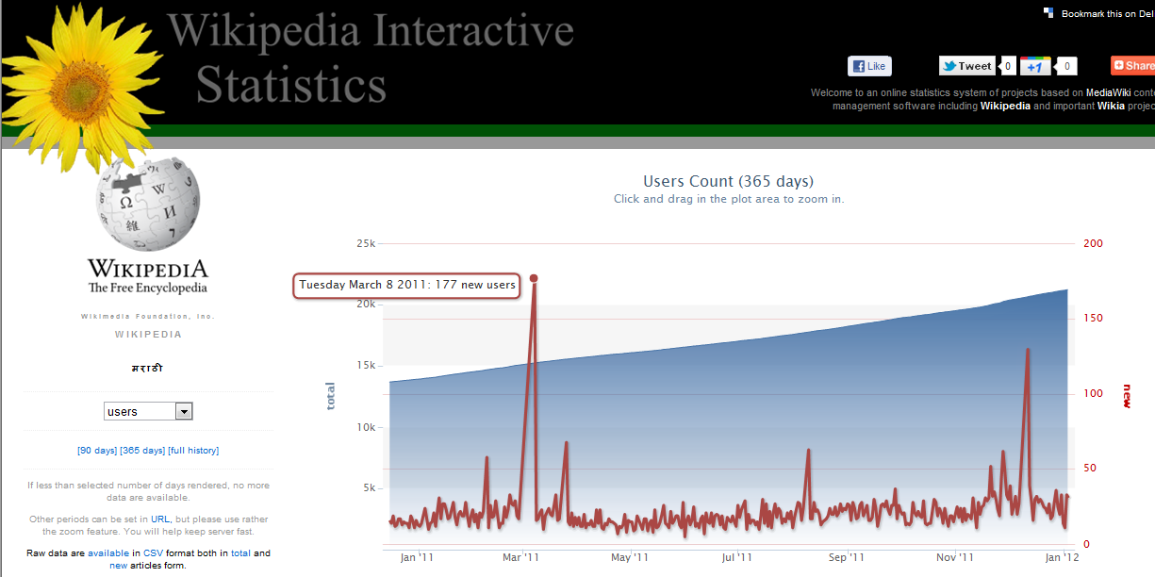

Slide 5
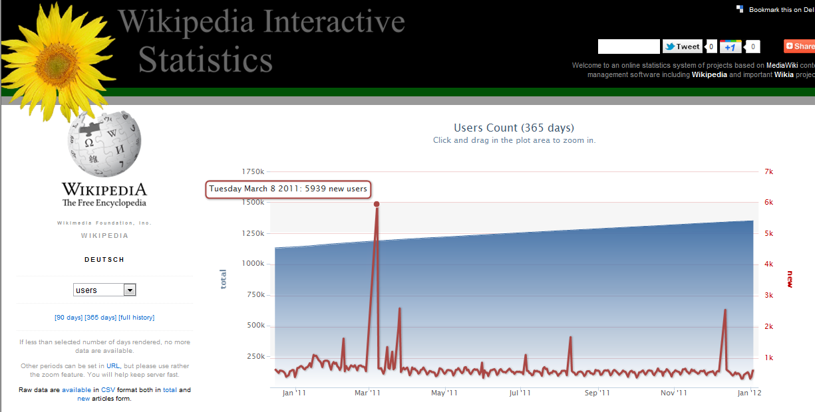

Slide 6
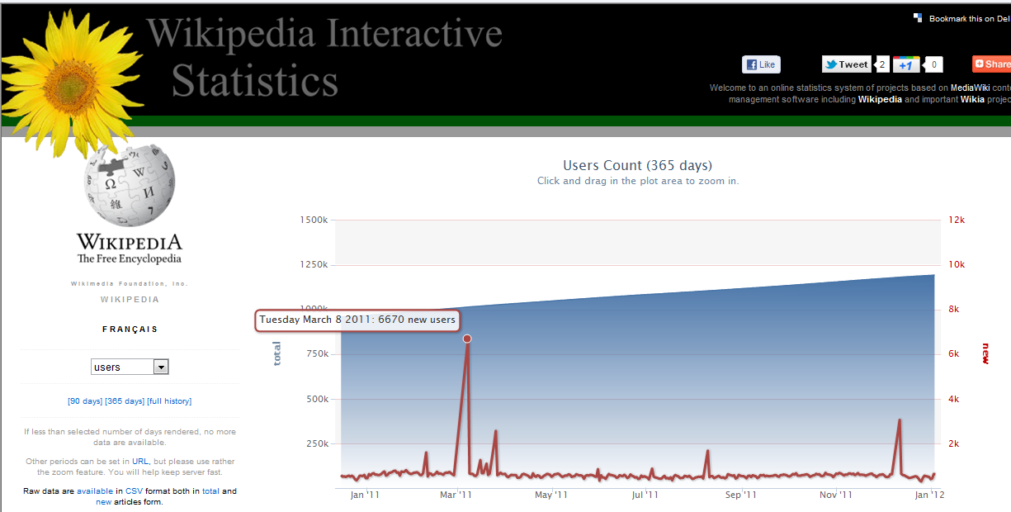

Slide 7
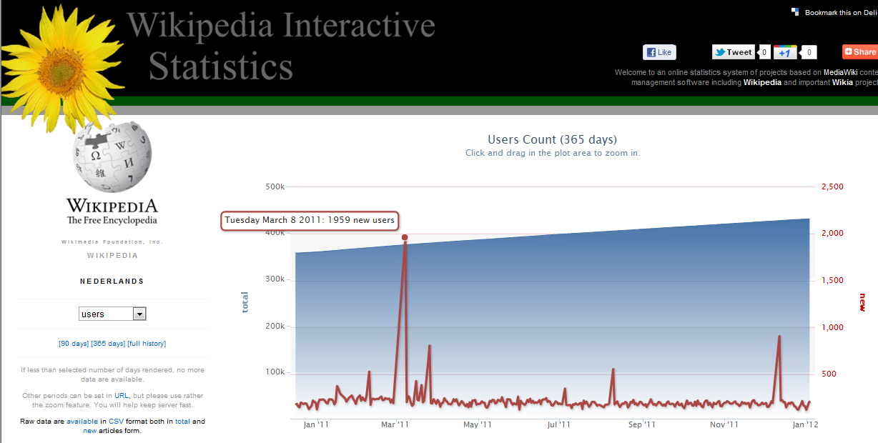

Slide 8
Thanks

