Slide 1
Wikipedia as a key public health tool
Dr Thomas Shafee
@WikiJMed
@WikiJSci
@WikiJHum
Leveraging the worlds most-read information source
CC BY 4.0
Notes:
Average 1.5 min per slide → 50 mins including short demos
Best to maximise time on interactive section

Slide 2
Why edit Wikipedia and sister projects?
Selfless
Selfish
The noble cause of free information
Giving back to a resource you’ve benefitted from
Expert input on difficult topics
Being part of the world’s largest open-access project
Public engagement and education
Massive exposure and reach
Ensure your field is thoroughly and accurately represented
First google hit for most topics
(Students, Reviewers, Grant assessors, Journalists, Policymakers)
Maximise use of the writing and images that you’ve already done
Improve your non-specialist writing
Notes:
Probably best public engagement you’ll ever do (e.g. grant writing?)
If your topic is not covered, it can give a false impression of obscurity
If your paper is reviewed by a scientist outside your field what are the odds they’ll check Wikipedia?
Get PhDs and Postdocs involved.
Orders of magnitude more views than highest review paper.

Slide 3
Outline
Why should you be interested in editing Wikipedia?
A brief introduction to the largest encyclopaedia of all time
Why it needs you and why you need it
How to edit
How to edit right!
Text, images, references
Best practice and common pitfalls
Part of the wider knowledge ecosystem
Connected projects and collaborations
The hidden world behind Wikipedia
Help, community and resources
Icons: MGalloway WMF (Wikimedia commons)

Slide 4
Use of the internet for medical info
72% of internet users report having looked online for health information within the past year
53% state that it influenced their decision
35% did not follow up their searches by visiting a clinician
NO
YES
Fox, S; Duggan, M. (2013). Health online. Pew Research

Slide 5
Competing sources of medical information
Of the many competing sources, most are non-commercial
Wikipedia’s med content dominates most search engine results
Heilman, J.M. and West, A.G., 2015. Wikipedia and medicine: quantifying readership, editors, and the significance of natural language. Journal of medical Internet research, 17(3), p.e62.
Notes:
Good news is mostly non-commercial (some advert, some subscription)
Wikipedia overall readership approx 100 billion per year

Slide 6
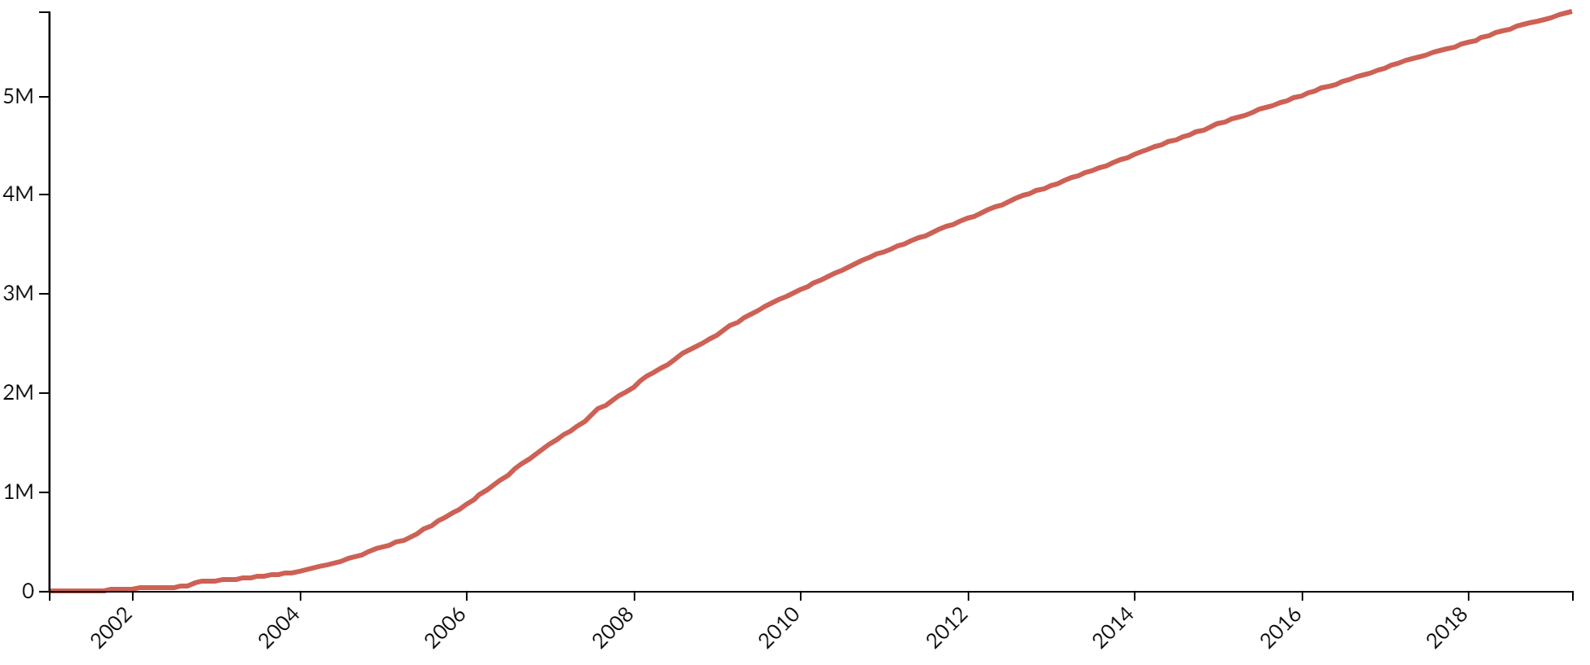
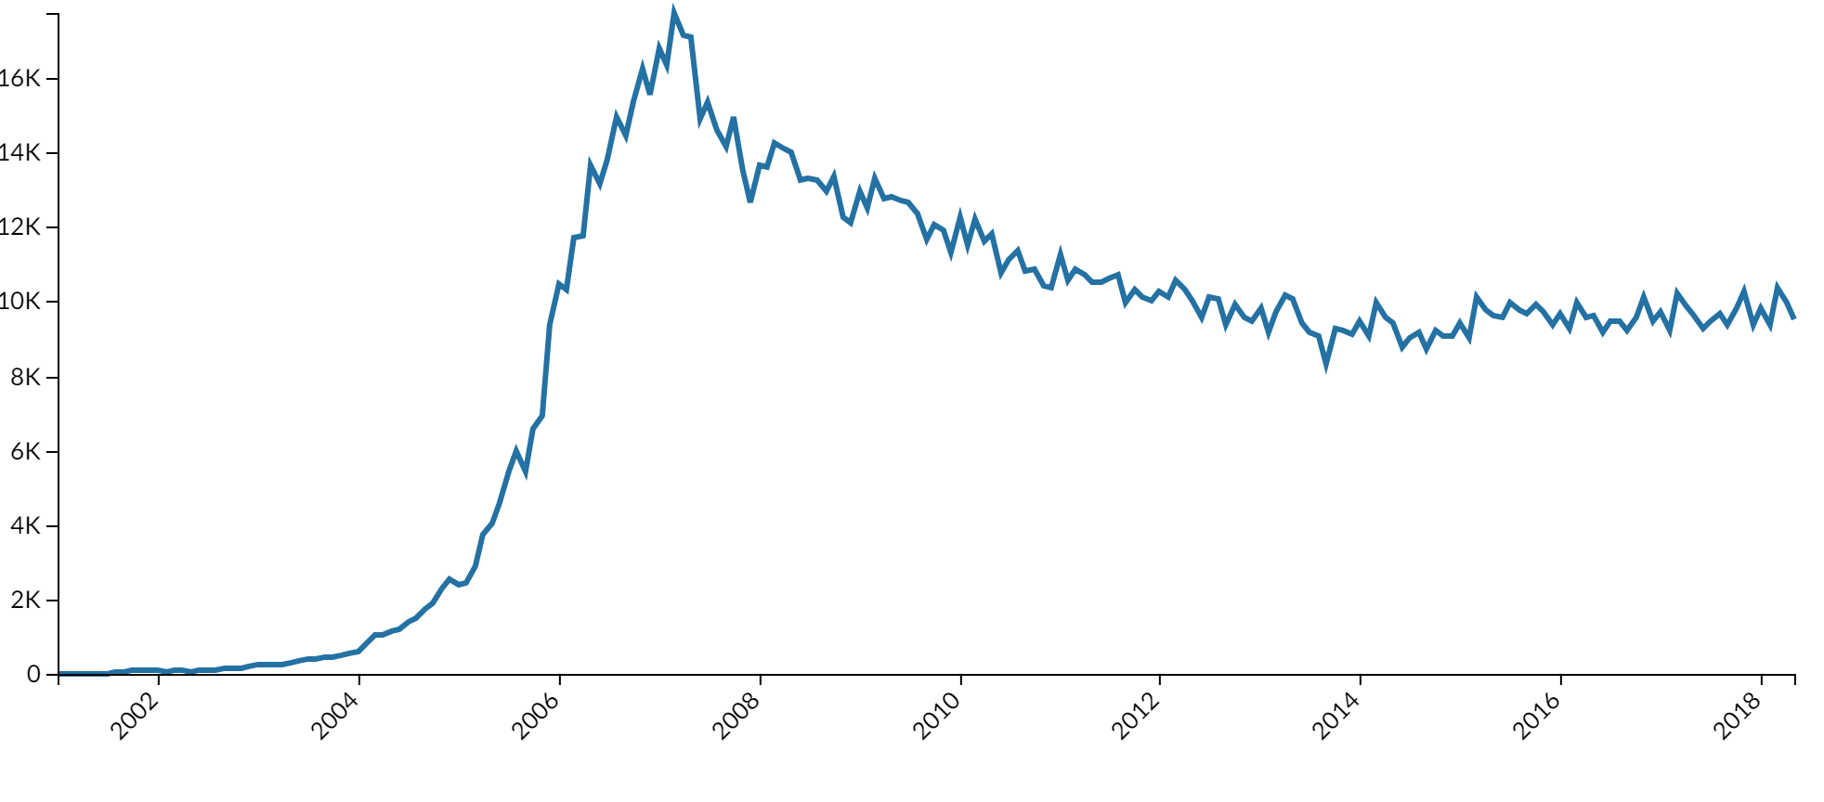
A brief history
2001 began
2007 editing peak
But poor accuracy
Stricter standards lead to fall-off in editors
2015 plateau
Concerted recruitment
Easier editing tools
First year since 2007 with editor growth
In 295 languages
5th busiest website
Articles
Editors*
Stricter standards
Recruitment
Easier editing tools
* 25-100 edits per month
Data: https://stats.wikimedia.org/v2
Notes:
2007 lowest average quality and highest reversion rate

Slide 7
Who reads Wikipedia?
Thesis
1-10
Median Wikipedia page
10,000 pa
Median Journal Paper
800
Top 5% Journal Paper
3,000
Top 5% Wikipedia page
1,000,000 pa

Slide 8
Who reads Wikipedia’s medical content?
General
public
Medical students
Practicing doctors
Research scientists
+ Patients, journalists, lawmakers, etc.
Fox S, Jones S. Pew Internet. 2009 | Hughes B, Joshi I, Lemonde H, Wareham J. Int J Med Inform 2009 Oct;78(10):645-655 | Allahwala UK, Nadkarni A, Sebaratnam DF. Med Teach 2013 Apr;35(4):337 | Nutzung von Social-Media-Diensten in der Wissenschaft 2017 Goportis – Leibniz-Bibliotheksverbund
Notes:
Also 87% of teachers
Also 35% of pharmacists
Policymakers and Journalists
Lawmakers have cited Wikipedia in >400 judicial decisions

Slide 9
Putting that in perspective
Suicide prevention
Suicide among LGBT youth
Postpartum depression
Psychology of torture
Dehumanization
Family therapy
Epidemiology of depression
Digital media use and mental health
Lithium (drug)
Short-term memory
100,000 – 1,000,000 reads per year

Slide 10
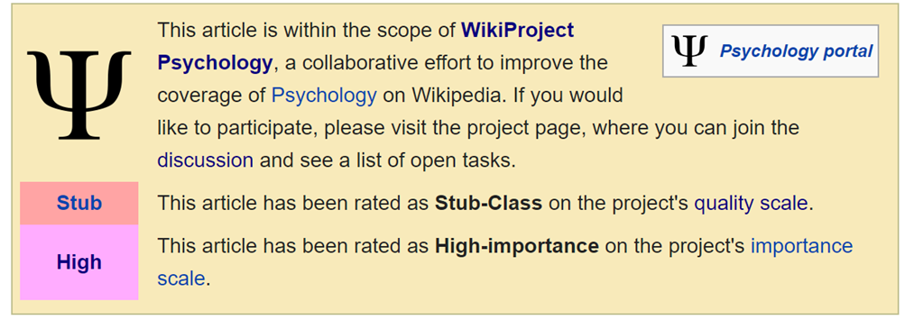
Article quality: internal review
Articles are rated
Importance
Quality
Top two quality ratings
Promoted by review
Status
Displayed on talk page
Status can also be revoked by review
Pseudo
peer-reviewed
https://en.wikipedia.org/wiki/Wikipedia:Version_1.0_Editorial_Team/MCB_articles_by_quality_statistics

Slide 11
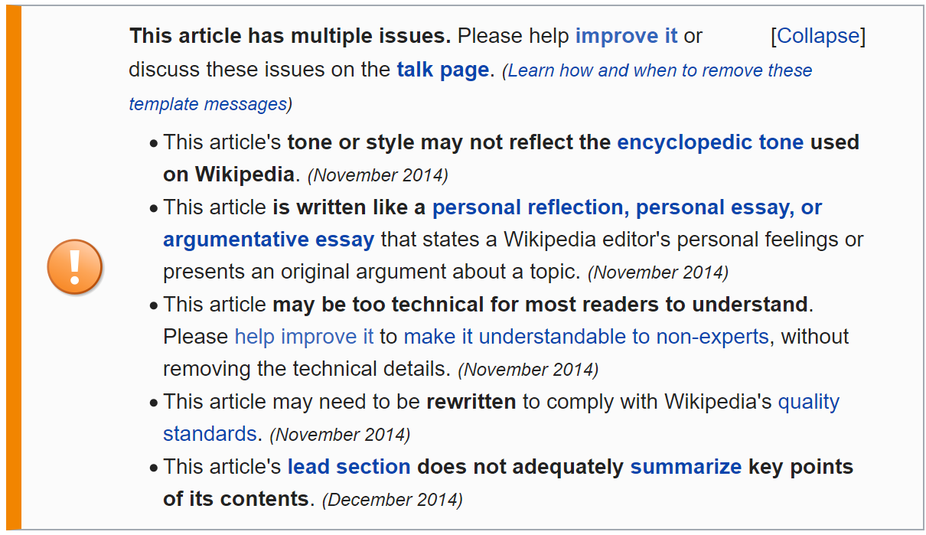
Article quality: internal review
Significant issues are tagged with warnings
Articles can have a variety of additional tags added

Slide 12
Article quality: external review
Quality comparable to Encyclopædia Britannica even back in 2005
Accuracy varies by topic, but broad trends:
Inconsistent coverage
Missing / out of date information
Missing illustration
Difficult readability
Accuracy has immediate, real-world impact
Internet medical data influences the healthcare decisions of >50% of readers
Many articles are read a million times per year
Yet is has been consistently difficult to engage academics, experts and health professionals
Nature 2005 438:900 | S Fox, M Duggan Pew internet 2013

Slide 13
Who writes Wikipedia?
Admins & Bureaucrats (600 active)
Peer exam and interview
Can mark pages as protected and block editors
Some niche privileges (e.g. delete pages, allow editing bots)
Editors (30,000 active)
Access to Visual Editor
Persistent reputation
Able to edit protected pages
Anonymous users (⅓ of all edits)
Text recognition test to prove human
Edits are marked with ip address
Can edit >99% of pages
Data: http://stats.wikimedia.org/EN/TablesWikipediaEN.htm ; http://stats.wikimedia.org/EN/EditsRevertsEN.htm ; https://en.wikipedia.org/w/index.php?title=Wikipedia:List_of_administrators/Active&action=history
Notes:
Whole systems runs as microdemocratic anarcho-beurocracy but is not purely any of these

Slide 14
How is Wikipedia ruled?
Democracy
Elected committees
Content by consensus
Bureaucracy
Policies and guidelines
Manual of style
Anarchy
Fully volunteer
Extremely flexible system
No centralised task delegation

Slide 15
Outline
Why should you be interested in editing Wikipedia?
A brief introduction to the largest encyclopaedia of all time
Why it needs you and why you need it
How to edit
How to edit right!
Text, images, references
Best practice and common pitfalls
Part of the wider knowledge ecosystem
Connected projects and collaborations
The hidden world behind Wikipedia
Help, community and resources
Icons: MGalloway WMF (Wikimedia commons)

Slide 16
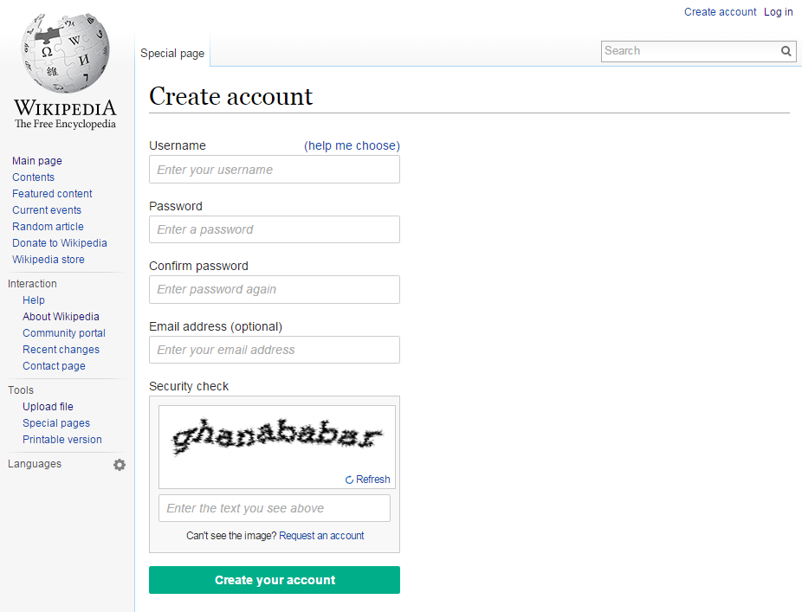
Signing up
Pseudonym
Orthonym
To try editing a blank test page, sign up and click “Sandbox”

Slide 17
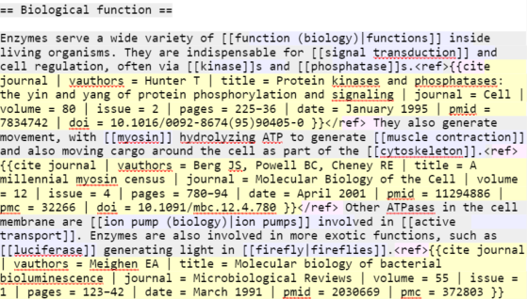
The two ways to edit
Edit source
Scripting language (‘Markup’)
Versatile with experience
Very few things you actually need to know
[[link]] → link
[[link | other words]] → other words
‘‘italic’’ → italic
‘‘‘bold’’’ → bold
*bullet → • bullet
==Heading== → Heading
===Subheading=== → Subheading
References are tricky
Notes:
Source gets hard to read with many references

Slide 18
The two ways to edit
Edit source
Scripting language (‘Markup’)
Versatile with experience
Very few things you actually need to know
[[link]] → link
[[link | other words]] → other words
‘‘italic’’ → italic
‘‘‘bold’’’ → bold
*bullet → • bullet
==Heading== → Heading
===Subheading=== → Subheading
Edit (VisualEditor)
Edit like word processing software
More intuitive
Example
- Write some text -
- Add a reference -
- Summarise and save -
Notes:
Source gets hard to read with many references

Slide 19
Talk pages
Topic discussion
Uncertain edits
Controversial edits
Suggested improvements
Header banners
Page rating
Wikiproject
Currently can’t use VisualEditor
Need to use mark up text
~~~~ → Signature

Slide 20
Useful peripheral features
User pages
Pseudonym / orthonym
Editing aims
Brief biography
Points of pride
User talk pages
Discussion
Notifications
User sandbox
Personal testing area
Try things out without accidentally breaking articles
Watchlist
Any changes to your favourite pages
Wikipedia-wide announcements
History
Permanent record of all versions of a page
Summary descriptions and sizes of edits

Slide 21
Creating a new article
Upload as Draft:XYZ
- Using “Articles for Creation” -
- WP:AFC -
Editor review
- Notability -
- Sufficient References -
- Formatting -
Moved to XYZ page
- Rating -
- Ongoing improvement -
https://en.wikipedia.org/wiki/Wikipedia:Articles for creation WP:AFC
Notes:
If image not listed for embed, reload page.

Slide 22
Copyright
Be careful not to violate copyright when adding to Wikipedia
Plagiarism detectors monitor all edits (TurnItIn)
All text is under the Creative Commons licence
Share copy and redistribute the material in any medium or format
Adapt remix, transform, and build upon the material for any purpose (even commercial)
Attribute credit must be given (link to the license, and indicate any changes)
Share alike if you do reuse this information, it must be distributed under the same license
Images are also Creative Commons by default
Optionally Remove share alike requirement
Remove all requirements (full public domain)
https://creativecommons.org/licenses/by-sa/4.0/

Slide 23
Outline
Why should you be interested in editing Wikipedia?
A brief introduction to the largest encyclopaedia of all time
Why it needs you and why you need it
How to edit
How to edit right!
Text, images, references
Best practice and common pitfalls
Part of the wider knowledge ecosystem
Connected projects and collaborations
The hidden world behind Wikipedia
Help, community and resources
Icons: MGalloway WMF (Wikimedia commons)

Slide 24
Similarities to academic writing
Neutral point of view [[WP:NPOV]]
Balanced information
Cite reliable, verifiable sources [[WP:RS]] [[WP:VER]]
Avoid plagiarism [[WP:PLAG]]
Several detection bots search for instances
Don’t accidentally copyvio yourself!
Short lead abstract [[WP:LEAD]]
Permanent record
Open-access mentality [[WP:FIVEPILLARS]]
Post-publication peer review (of a sort)
Continuous editing and improvement by other authors
Organised peer review for ‘Good Article’ or ‘Featured Article’ status [[WP:GA]] , [[WP:FA]]
https://en.wikipedia.org/wiki/User:CorenSearchBot
Notes:
You’re already well set up for good editing practice
Don’t put in 5 paragraphs on some obscure point on a page.
Probably more citations than typical introduction (No personal comms, or unpub data)

Slide 25
A brief sidenote on shortcuts [[WP:CUTS]]
WP:XYZ links shortcut to various ‘behind the scenes’ pages
Policies
Tools
Community pages
Wikiprojects
WP:AFD - WP:OR, WP:N, WP:V
Nominated article for deletion due to original research and lack of notability; in addition, it does not appear to be possible to verify the accuracy of the sources, as the article contains only references that are contained in unpublished manuscripts.

Slide 26
Differences to academic writing
Content & format
Referencing & quality
Peers & collaboration

Slide 27
Differences (content & format)
General audience! [[WP:TECHNICAL]]
Everything should be understandable to a undergraduate
The first paragraph should be understandable to a secondary school pupil
Wikilink to key relevant topics [[WP:LINK]]
Writing style [[WP:MOS]]
No referencing images, they should stand alone
Minimise name-dropping
Date-relevant statements become out of date quickly
Avoid review-style colloquialisms
See figure 5
Jones et.al. have demonstrated that...
In this article we focus on examples from proteases…
Currently / the newest / recent…

Slide 28
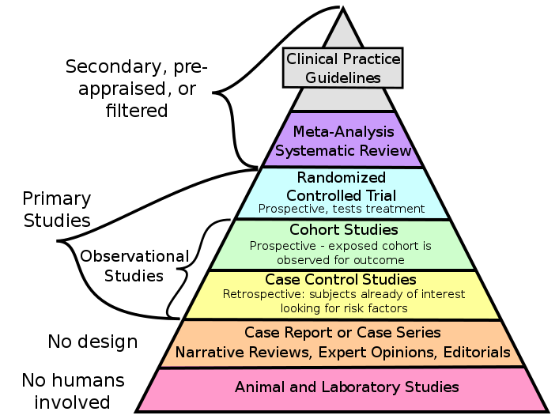
Differences (references & quality)
Secondary sources are preferred [[WP:SCIRS]] [[WP:MEDRS]]
Especially for medical statements
Compromise: cite both secondary and primary research
No original research [[WP:NOR]]
Including synthesis of information
Can only summarise published work
Constant post-publication review and update [[WP:WIP]]
Notes:
Referenceing and quality
Not just published or not. Can go up (and down) over time

Slide 29
Differences (peers & collaboration)
No ownership [[WP:OWN]]
There’s no official lead or corresponding author
Everyone’s equal [[WP:FIVEPILLARS]] , [[WP:BE BOLD]]
You may sometimes need to explain your edits to people with less knowledge then you
Editors don’t have to be experts on the topic or on Wikipedia editing
The average edit is more helpful than harmful
Notability [[WP:NOTE]]
Academic biographies must be particularly so [[WP:PROF]]
Disagreements [[WP:DISPUTE]]
Article’s talk page
Dispute resolution mediation request [[WP:DRR]]
Notes:
And you will certainly all be better than average editors so don’t worry about breaking things. People will catch your mistakes.
You own nothing.
Resolution either by one-off third opinion, formal

Slide 30
Outline
Why should you be interested in editing Wikipedia?
A brief introduction to the largest encyclopaedia of all time
Why it needs you and why you need it
How to edit
How to edit right!
Text, images, references
Best practice and common pitfalls
Part of the wider knowledge ecosystem
Connected projects and collaborations
The hidden world behind Wikipedia
Help, community and resources
Icons: MGalloway WMF (Wikimedia commons)

Slide 32
A massive media repository
Multimedia file repository
Images
Video
Sound
Public domain / Freely-licensed
Creative commons licenses
Content scope
Educational
Informative
Instructional
Like all Wikimedia projects, free and volunteer-run

Slide 33
The future of data
Free, open, structured knowledge base
Humans and machine readable and editable
Multilingual, queryable
Standardised, centralised, highly interlinked
Statements, sources, and connections to other databases
Item | Property | Value
Q42 | P69 | Q691283
Douglas Adams | educated at | St John's College

Slide 34
Wikiversity
Open courses, targeted to any education level
Formatted as teaching resources
Flexible organisation structure
Example: “What We Wish They Knew: 13 Reasons Why”
Organised epis-de-by-episode and theme-by-theme
Information directory
Example: “Dealing With a School Shooting”
Written for caregivers, professionals and members of the public
4-week process, questions, resources

Slide 35
Bridging the academic divide
WikiJournal
Content published into both Wikipedia and academic corpus
Stable, citable, peer-reviewed version with the credibility of a scholarly journal
Living version with extreme impact of Wikipedia
Example journals
PLOS Genetics
PLOS CompBiol
Wiki.J.Med
Wiki.J.Sci
Wiki.J.Hum
Gene
RNA Biology
Journal first
Wikipedia first
Parallel
Notes:
Additional note: PLOS and WikiJournals are free and open access.

Slide 36
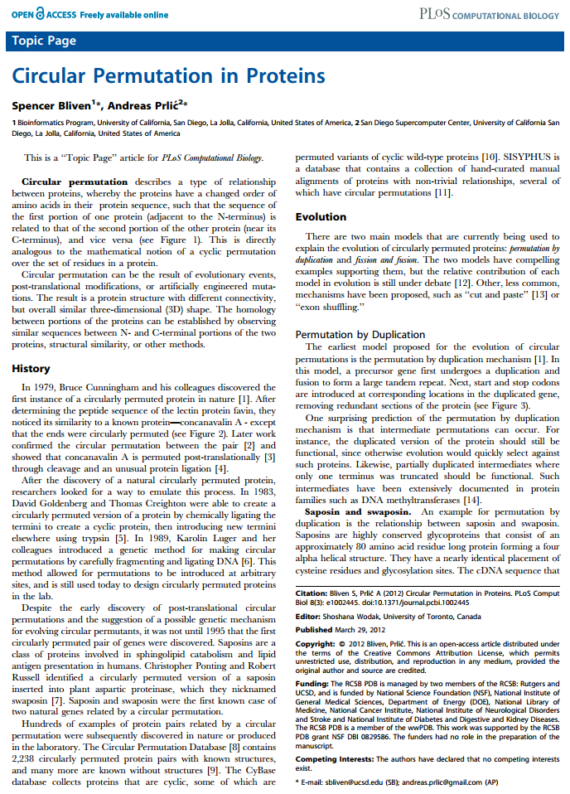
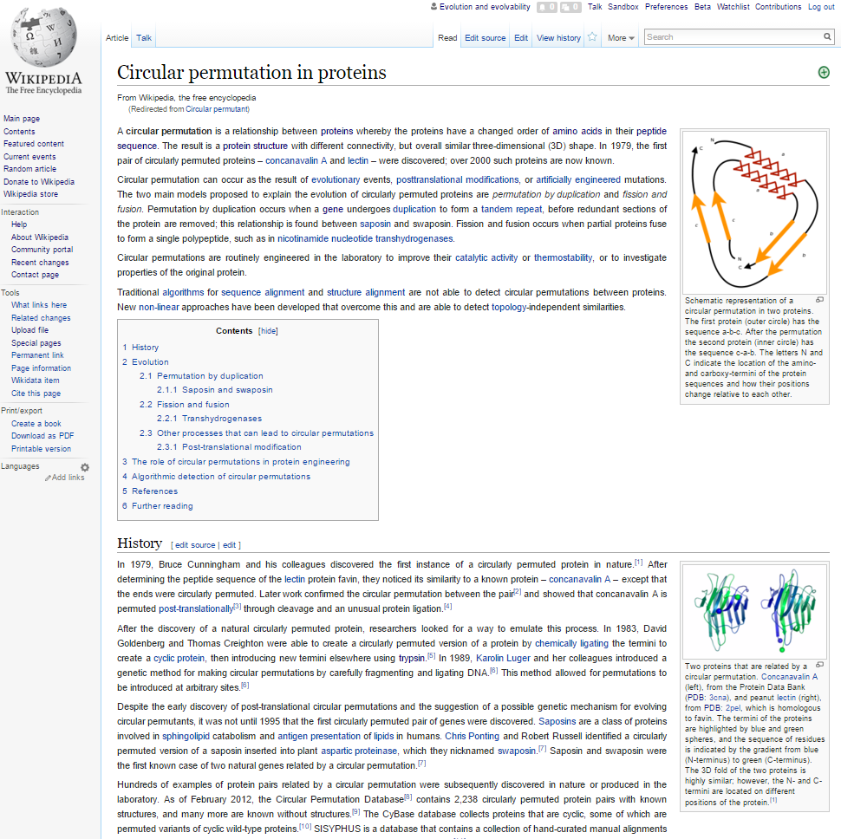
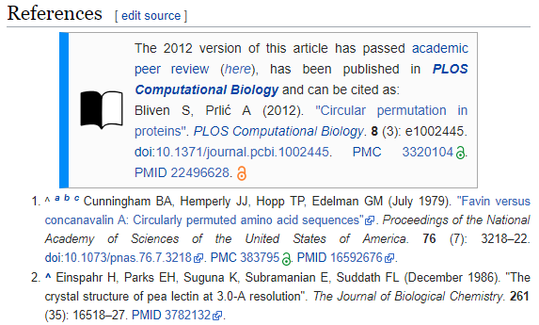
Academic and Wikipedic versions
WikiJournal

Slide 37
International projects
WikiEdu
Wikipedia editing as part of assessed student coursework
Used in psychology courses at dozens of US universities
e.g. UCLA, Uni North Carolina, Uni Michigan, FIU
WikiJournals
Academic journals that dual-publish 1) stable version of record, 2) into Wikipedia
ORCID integration
WikiCite

Slide 38
Project and collaboration formats
Institutional
/ Long-term
Wikipedian in Residence
Formal, ongoing partnerships
Repeating meetups
Edit-a-thons / Wikibombs
Treasurehunts (content, images, citations)
Edit training (Wikipedia, Wikidata, Commons)
Individual
/ Short-term

Slide 39
Outline
Why should you be interested in editing Wikipedia?
A brief introduction to the largest encyclopaedia of all time
Why it needs you and why you need it
How to edit
How to edit right!
Text, images, references
Best practice and common pitfalls
Part of the wider knowledge ecosystem
Connected projects and collaborations
The hidden world behind Wikipedia
Help, community and resources
Icons: MGalloway WMF (Wikimedia commons)

Slide 40
Community
General community portal [[WP:COM]]
Help, suggestions, news
Regional Wikimedia Chapters meta.wikimedia.org/wiki/Affiliates
Wikiprojects [[WP:WPDIR]]
Psychology
Medicine
Sociology
Neurobiology
Women's Health
LGBT studies
Death

Slide 41
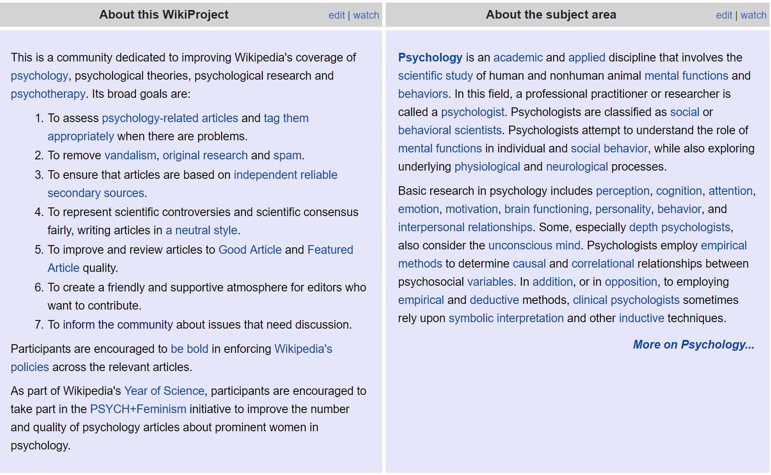
WikiProject Psychology [[WP:PSY]]

Slide 42
Further help
Interactive help (scarily fast response times)
Teahouse for new editors [[WP:TH]]
Helpdesk for experienced editors [[WP:HD]]
Tutorials
General tutorial [[Help:Intro]]
Academic-specific advice
Ten simple rules for editing Wikipedia - Logan et. al. (2010) Plos Comp. Bio.
This presentation is freely available online
https://en.wikipedia.org/wiki/File:Wikipedia_Workshop.pdf
Just search “File:Wikipedia_Workshop.pdf”

Slide 43
Contact
Email Thomas.Shafee@gmail.com
Google Scholar Thomas Shafee
ResearchGate Thomas Shafee
LinkedIn Thomas Shafee
Journals
WikiJournal of Medicine (WikiJMed.org)
WikiJournal of Science (WikiJSci.org)
PLOS (TopicPagesWiki.plos.org)
Wikipedia
My userpage Search “User:tshafee”
WikiProject Medicine Search “WP:MED”
Shafee, T; Mietchen, D; Su, A. (2017). “Academics can help shape Wikipedia”. Science. 357 (6351): 557–558.
Shafee, T; Masukume, G; Kipersztok, L; Das, D; Häggström, M; Heilman, J. (2017). “The evolution of Wikipedia’s medical content: past, present and future”. JECH. 71(10).
Shafee, T (2017) “Wikipedia-integrated publishing: A comparison of successful models”. Health Inform. 27(2)
WikiJSci Editorial Board (2018). “The aims and scope of WikiJournal of Science”. WikiJournal of Science 1(1):1

Slide 44
Tools
Useful for understanding article connectivity
Page information
Revision history search – Tracks down who made an edit
Revision history statistics – Statistics on edits
Page view statistics – Statistics on reader visits
WikiWand (prettifying Wikipedia)

Slide 45
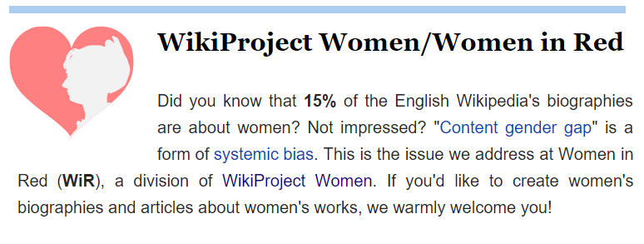
Community
General community portal [[WP:COM]]
Help, suggestions, news
Wikiprojects [[WP:WPDIR]]
Molecular and Cell Biology
Computational biology (Yearly $500 competition)
Genetics
Biophysics
Chemistry
Example
- Request help -
- Sign -

Slide 46
Who writes Wikipedia?
Wikimedia Foundation
Wikimedia foundation
Wikimedia Board of Trustees
Wikimedia staff
Hosts and administers ecosystem
Technical
Wikimedia tech staff
Template makers
Instructional content writers
Builds and
improves infrastructure
Article curators
New Page Patrol
Recent Changes Patrol
Copyeditors
Spellcheckers
Taggers
Vandalism reverters
Articles for deletion (AfD)
Bots
Builds and improves infrastructure
Improve articles once created
Content creators
New article creation
Article improvement
May assist with disputes
Revert
vandalism
Dispute resolution
Degrade articles
Elected committees
Arbitration Committee
Mediation Committee
Stewards
Bureaucrats
Admins
Article disruptors
Vandals
Hoaxers
Spammers
Viewpoint pushers
“Article Owners”
Dispute resolution about viewpoint pushing

Slide 47
A WikiJournal’s publishing flow
WikiJournal
Publication
PDF
Citable
Stable
Indexed
Version of record
Preprint
server
Public
peer review
HTML
doi
Highly accessed
Broad readership
Editable and updatable
Wikipedia-integration

Slide 48
A WikiJournal’s publishing flow
WikiJournal
Preprint server
Publication
PDF
Citable
Stable
Indexed
Version of record
Public
peer review
HTML
doi
Highly accessed
Broad readership
Editable and updatable
Wikipedia as preprint
Wikipedia-integration

