Slide 1
Wikipedia-integrated medical journals
Dr Thomas Shafee
@WikiJMed
@WikiJSci
@WikiJHum
a key health literacy and outreach platform
CC BY 4.0

Slide 2
Outline
Combining reach and rigour
Implementation models & examples
What does the future hold
Notes:
with illustrative examples as case studies

Slide 3
Combining reach and rigour
compatible interfaces between two worlds

Slide 4
Who reads Wikipedia?
Thesis
1-10
Median Wikipedia page
10,000 pa
Median Journal Paper
800
Readership includes: Patients
Students
Journalists
Lawmakers
Clinicians
Top 5% Journal Paper
3,000
Top 5% Wikipedia page
1,000,000 pa
Shafee T (2017) Wikipedia-integrated publishing: a comparison of successful models. Health Inform. 26(2)
Notes:
Re-emphisise that patients are making health decisions based on what they read online

Slide 5
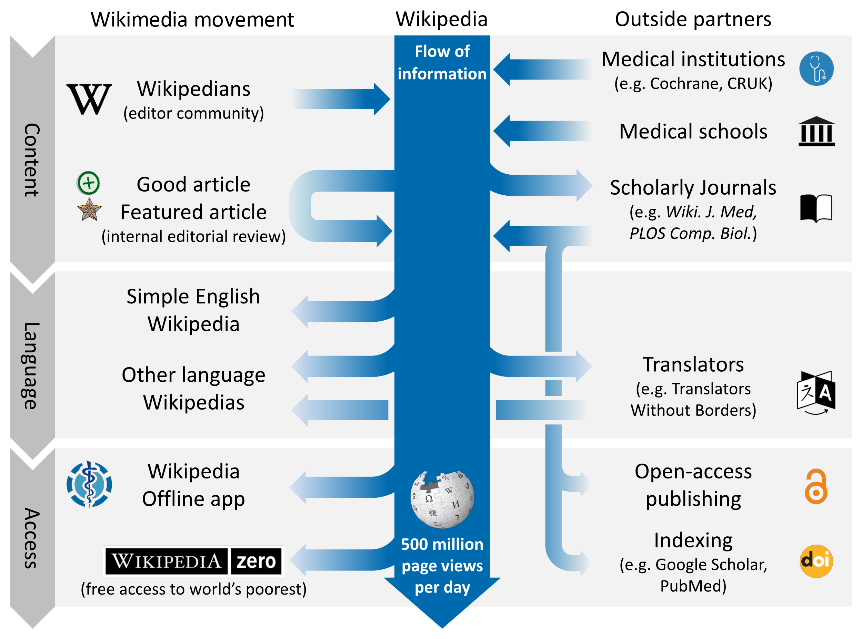
Shafee, T. et al. (2017). Evolution of Wikipedia’s medical content: past, present and future. JECH. 71(10)
Notes:
Also competitions for most improved article (e.g. Comp boil, WikiJMed)

Slide 6
Similarities and differences
 | Academic Journal | Wikipedia
Readership size | Small and brief Median article - 800 total Top 5% article - 3000 total | Very large and extended Median article - 10,000 per year Top 5% article - 1,000,000 per year
Readership composition | Other academics, often within narrow field | General public as well as experts and professionals
Peer review | Pre-publication, private review by 2-4 subject specialists | Post-publication public review of a sort by subject generalists ‘Good article’ - 1 reviewer ‘Featured Article’ - 5-12 reviewers
Reputation | Varies by journal but generally extremely high | Public generally trust Academics have mixed opinions by improving
Authorship | Small number with relevant, accredited expertise. Organised group with lead and corresponding authors. | Large number with mixed expertise levels. Loose organisation. Many pseudonymous or anonymous.
Timeliness | Static Updated by new publications | Constantly updated Only one consensus version
Shafee, T. et al. (2017). Evolution of Wikipedia’s medical content: past, present and future. JECH. 71(10)

Slide 7
Implementation models
Practical and proven methods

Slide 8
Bridging the academic divide
Content published into both Wikipedia and academic corpus
Stable, citable, peer-reviewed journal version
Living version with extreme impact of Wikipedia
Example journals
PLOS Genetics
PLOS CompBiol
PLOS ONE
Wiki.J.Med
Wiki.J.Sci
Wiki.J.Hum
Open Medicine
Gene
RNA Biology
Journal first
Wikipedia first
Parallel
Shafee, T. (2017). Wikipedia-integrated publishing: a comparison of successful models. Health Inform., 26(2).

Slide 9
Bridging the academic divide
Compatible with any OA journal
Simplest workflow
Well-suited to topics that are missing/start/stub on Wikipedia
Journal first
Restricted by Wikipedia’s CC-BY-SA license
May be only option for highly-developed pages (full replacement typically more difficult Class B and above)
Wikipedia first
Compatible with closed journal
Two versions can be tailored to different audiences
Increased work for authors and reviewers
Parallel
Shafee, T. (2017). Wikipedia-integrated publishing: a comparison of successful models. Health Inform., 26(2).

Slide 10
Wikipedia article quality
Articles are rated
Importance
Quality
Top two quality ratings
Promoted by review
Can also be revoked by review
Status
Displayed on talk page
Affects ideal updates mechanisms
Wikipedia’s psychology pages
Update using Wikipedia page contents as starting point
Pseudo
peer-reviewed
Update by re-writing from scratch
In all quality ratings cases, individual article sections can typically be rewritten from scratch
https://en.wikipedia.org/wiki/Wikipedia:Version_1.0_Editorial_Team/MCB_articles_by_quality_statistics

Slide 11
Example case studies
Full review articles
Article sections
Existing high-quality Wikipedia article updated and submitted
Hippocampus
Wikipedia article previously existing but flawed/outdated
Lysine
Wikipedia article previously completely absent/stub
Anthracyclines
Section of Wikipedia article warranted own page
Gene structure
Wikipedia articles previously lacked images
Cell disassembly during apoptosis

Slide 12
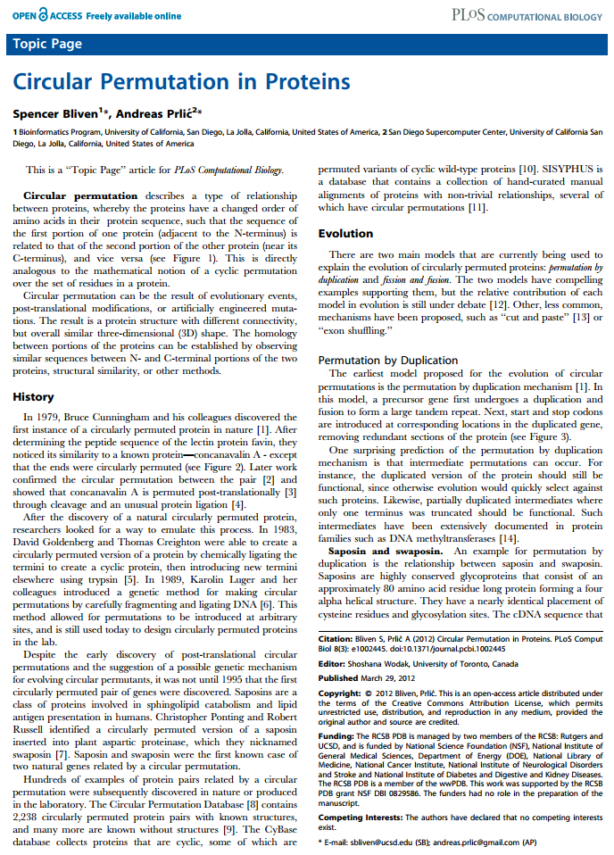
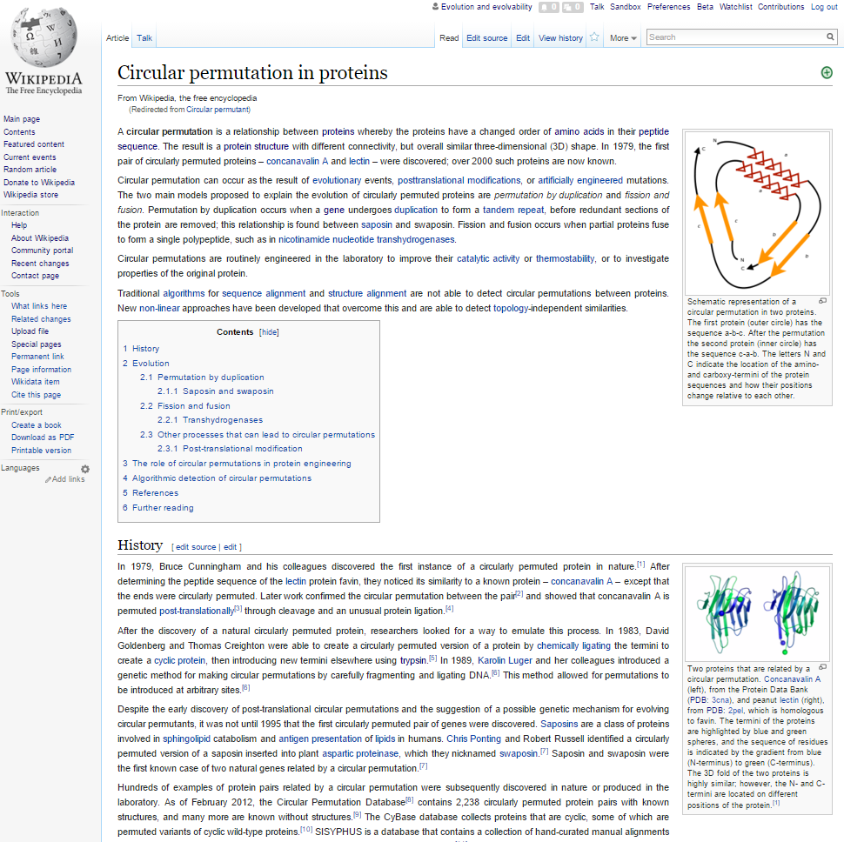
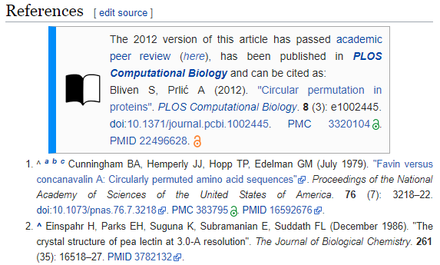
Academic and Wikipedic versions

Slide 13
WikiJournals

Slide 14
A WikiJournal’s publishing flow
Publication
PDF
Citable
Stable
Indexed
Version of record
Preprint
server
Public
peer review
HTML
doi
Highly accessed
Broad readership
Editable and updatable
Wikipedia-integration
WikiJSci Editorial Board. (2018). The aims and scope of WikiJournal of Science. WikiJSci 1(1)

Slide 15
A WikiJournal’s publishing flow
Preprint server
Publication
PDF
Citable
Stable
Indexed
Version of record
Public
peer review
HTML
doi
Highly accessed
Broad readership
Editable and updatable
Wikipedia as preprint
Wikipedia-integration
WikiJSci Editorial Board. (2018). The aims and scope of WikiJournal of Science. WikiJSci 1(1)

Slide 16
A WikiJournal’s publishing flow
Preprint server
Publication
PDF
Citable
Stable
Indexed
Version of record
Public
peer review
HTML
doi
Highly accessed
Broad readership
Editable and updatable
Versioning
Wikipedia as preprint
Wikipedia-integration
WikiJSci Editorial Board. (2018). The aims and scope of WikiJournal of Science. WikiJSci 1(1)

Slide 17
Committee on Publication Ethics
WikiJMed ethics statement audited and approved by COPE
WikiJMed.org/Ethics_statement
Attribution of CC material
Images / videos / other media: Attribution and license type at end of the figure legend
Text <1 paragraph / <10% of final work: Hyperlink to contributor list 'Acknowledgements' section
Text >1 paragraph / >10% of final work: Hyperlink to the full contributor list included in the author list (typically as a hyperlinked "et al"). Treated as “Large group authorship”.
Ownership
Journal article released by authors under creative commons license of their choice
Material integrated into Wikipedia may be edited by anyone (inc. authors) and will evolve over time
What constitutes a preprint
Wikipedia can be treated as a preprint server where the submitting author has been a significant contributor
Dual publication into Wikipedia
Material that complies with Wikipedia’s guidelines (e.g reviews / images) can be directly integrated via CC license
Materia that does not (e.g. original research / opinion / speculation) can be cited as a source in a Wikipedia article

Slide 18
Sooooo… who pays?
Reader subscription / author (e.g. Gene, RNA Biol)
Typically charge subscription fees
Article processing fee of $3300 and $2000 respectively
Journal fee waiver (e.g. PLOS)
For Topic Page review articles, PLOS waives its usual $2250 processing fee
Charitable foundation (e.g. Wiki.J.Med.)
Web hosting cost is covered by the Wikimedia Foundation
Editors donate volunteer labour so no fees of any kind

Slide 19
What does the future hold?
Maximising potential value

Slide 20
Wikimedia journal hosting platform
Wikipedia Sister project
In whole
WikiJournals
PLOS Genetics
Host
Format
Example
One-off
examples in negotiation
In part
Features
Free interface for formatting articles ready for Wikipedia
Expert editors who give free advice and assistance
Specialist tools for facilitating the process

Slide 21
Possible partnership system
One-off partnering with subject-specialist journals
Specialist journal: Invite authors, identify peer reviewers
WikiJournal: Advises on wikipedia policy compliance, readability and formatting
Resulting article co-published in specialist journal & WikiJournal
Then copied into Wikipedia per ‘journal-first’ model
Co-publishing example:
Staniszewska, S., et al. (2017). GRIPP2 reporting checklists: tools to improve reporting of patient and public involvement in research. Research involvement and engagement, 3(1), 13.
Staniszewska, S., et al. (2017). GRIPP2 reporting checklists: tools to improve reporting of patient and public involvement in research. British Medical Journal 358(1), j3453

Slide 22
Contact
Email Thomas.Shafee@gmail.com
Google Scholar Thomas Shafee
ResearchGate Thomas Shafee
LinkedIn Thomas Shafee
Journals
WikiJournal of Medicine (WikiJMed.org)
WikiJournal of Science (WikiJSci.org)
PLOS (TopicPagesWiki.plos.org)
Wikipedia
My userpage Search “User:TShafee”
WikiProject Psychology Search “WP:PSY”
Shafee, T; Mietchen, D; Su, A. (2017). “Academics can help shape Wikipedia”. Science. 357 (6351): 557–558.
Shafee, T; Masukume, G; Kipersztok, L; Das, D; Häggström, M; Heilman, J. (2017). “The evolution of Wikipedia’s medical content: past, present and future“. JECH. 71(10).
Shafee, T (2017) “Wikipedia-integrated publishing: A comparison of successful models”. Health Inform. 27(2)

