Slide 1
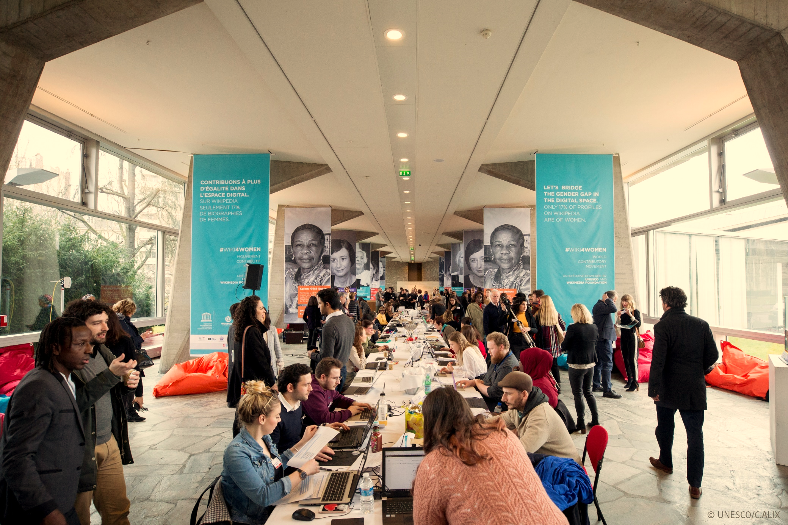
INTERNATIONAL WOMEN’S DAY 2019
WOMEN IN THE DIGITAL SPACE

Slide 2
INTERNATIONAL WOMEN’S DAY 2019
BACKGROUND :
A MOVEMENT LAUNCHED IN 2018
On March 8 2018, UNESCO organized the #WIKI4WOMEN Contributory Movement in order to improve the representation of women in the digital sphere by developing women's profiles on Wikipedia.
UNESCO’s partnership with the Wikimedia Foundation has helped form a new community of contributors around the issue of gender equality.
The first edit-a-thon at UNESCO Headquarters brought together 254 women and men, who created 119 new biographies, enriched or translated 185 articles, and wrote more than 400,000 words on Wikipedia. The simultaneous online participation mobilized over 700 people who generated even more articles and references worldwide.
In addition, 107 million people were exposed to the social media campaign linked to the event and the #WIKI4WOMEN video was viewed more than 81,000 times in less than a week thanks to the cumulative implication of all partners.

Slide 3
INTERNATIONAL WOMEN’S DAY 2019
TAKING THE MOMENTUM FORWARD: INTERNATIONAL WOMEN’S DAY 2019
EDIT-A-THON @HQ and digitally
Building on the dynamic and strong interest expressed in 2018 and focusing on the remaining gap (18.2% of biographies are women’s), on 8 March 2019, UNESCO will host a second edit-a-thon at UNESCO Headquarters in Paris as well as in Field Offices across the five regions: New Delhi, Dakar, Cairo/Beirut, Mexico, Bangkok,
The public will be invited to come and create, edit and translate profiles on Wikipedia of “missing women” in the fields of UNESCO, who still do not exist in the digital sphere. Participants are expected to number in the hundreds and will include the general public, students, partners and UNESCO staff, journalists, diplomats and Wikipedia editors. Wikipedia members will organize a training session for the new editors before the official launch of the event, and assist them throughout the day.
A digital campaign will also be developed in order to mobilize as many people as possible and invite them to join de the movement online. In order to maximize the impact, a communication agency, specialized in digital mobilization, will assist us. In addition, all UNESCO’s and partners’ networks will be mobilized.

Slide 4
INTERNATIONAL WOMEN’S DAY 2019
TAKING THE MOMENTUM FORWARD: INTERNATIONAL WOMEN’S DAY 2019
INTERNATIONAL WOMEN’S DAY TALKS
In addition to the Edit-a-thon, two talks will be organized on digital skills for girls and women, and on artificial intelligence and gender equality. Each talk will involve the participation of two speakers from the private sector, research and civil society, and be moderated by a journalist.
AN EXHIBITION ON WOMEN IN THE DIGITAL SPHERE
A circulating exhibition of portraits of 30 leading women in the digital space will be displayed on the UNESCO fences, between 15 February and 31 March 2019.
A YEAR LONG ANIMATED ONLINE COMMUNITY
If funds become available, UNESCO’s commitment to #WIKI4WOMEN will be sustained throughout 2019. The global community would be invited to join and edit all year long on their own with the online skills developed, as well as during dedicated events organized with the Wikimedia Foundation constituencies worldwide.
In order to achieve this, UNESCO would empower a community manager (part-time) to activate, stimulate and expand the community throughout the year. The community manager would be based in one of UNESCO’s Field Offices (Arab States or Africa, to be defined) and be supervised by the UNESCO HQ Communications team. The Wikimedia Foundation would be closely involved in this endeavor.

Slide 5
INTERNATIONAL WOMEN’S DAY 2019
2019 PARTNERS
2018 partners are invited to join in again and engage with UNESCO. Additional partners will be solicited in order to strengthen outreach for impact.
The entire UNESCO community will be mobilized around International Women’s Day, including staff and former staff at Headquarters, our field offices and Institutes; UNESCO delegations; UNESCO National Commissions; UNESCO Chairs; UNESCO Clubs; UNESCO associated schools, more than 370 NGOs we partner with, and civil society organizations associated with UNESCO.
Confirmed partners :
Corporate Wikipedia Foundation, national branches of the Wikimedia Foundation, and associations of Wikipedia contributors worldwide; the CHANEL Foundation ; International New York Time.
We strongly count on our partners to relay and promote the event and mobilize around them.

Slide 6
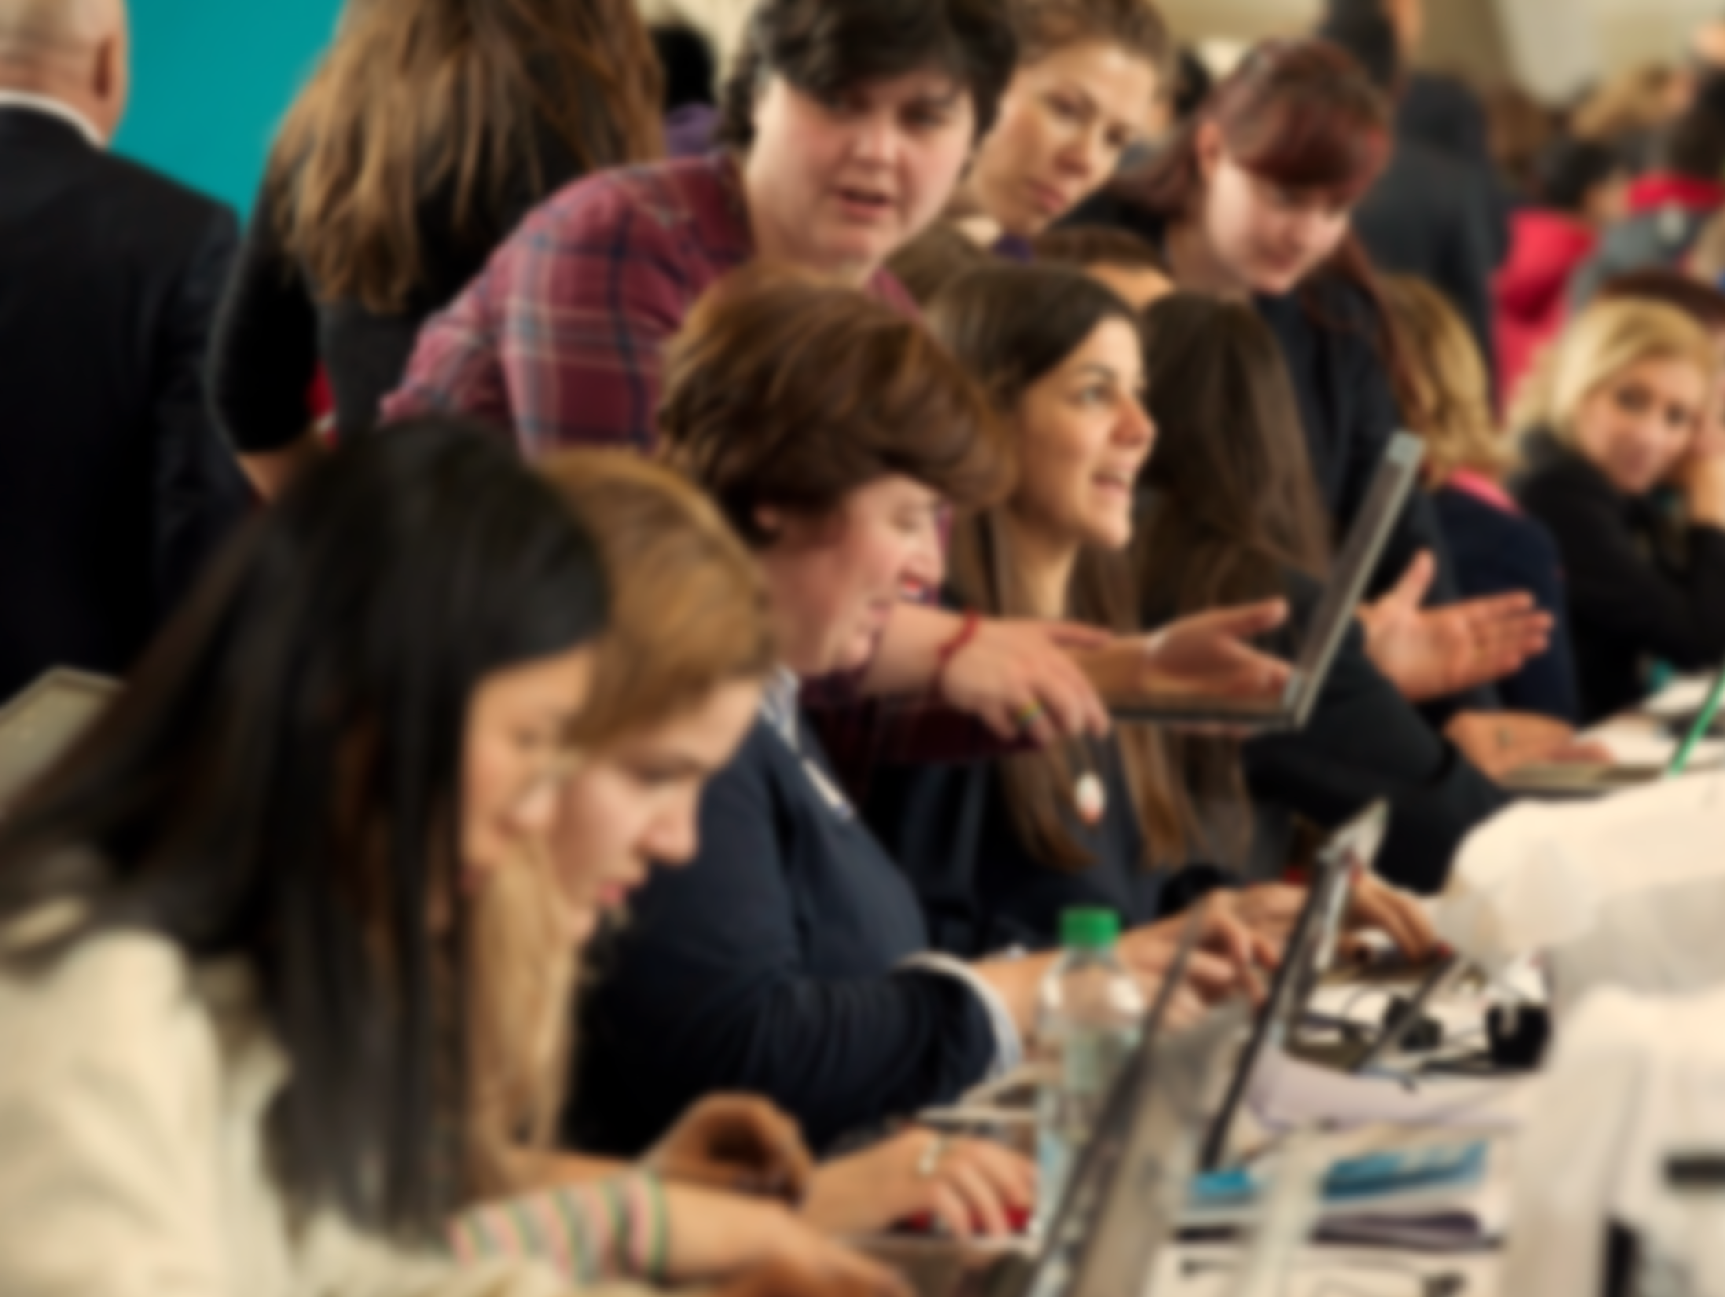
INTERNATIONAL WOMEN’S DAY 2019
JOINS US
CONTACTS
Ms S. Gülser Corat
Director
Gender Equality Division
sg.corat@unesco.org
Ms Armelle Arrou
Head
Public Relations and Partnerships
a.arrou@unesco.org

