Slide 1
INTRODUCTION TO THE WIKIMEDIA MOVEMENT
BY
FELIX NARTEY

Slide 2
Wikimedia is a global movement whose mission is to bring free educational content to the world.
Through various projects, chapters, and the support structure of the non-profit Wikimedia Foundation, Wikimedia strives to bring about a world in which every single human being can freely share in the sum of all knowledge.

Slide 3
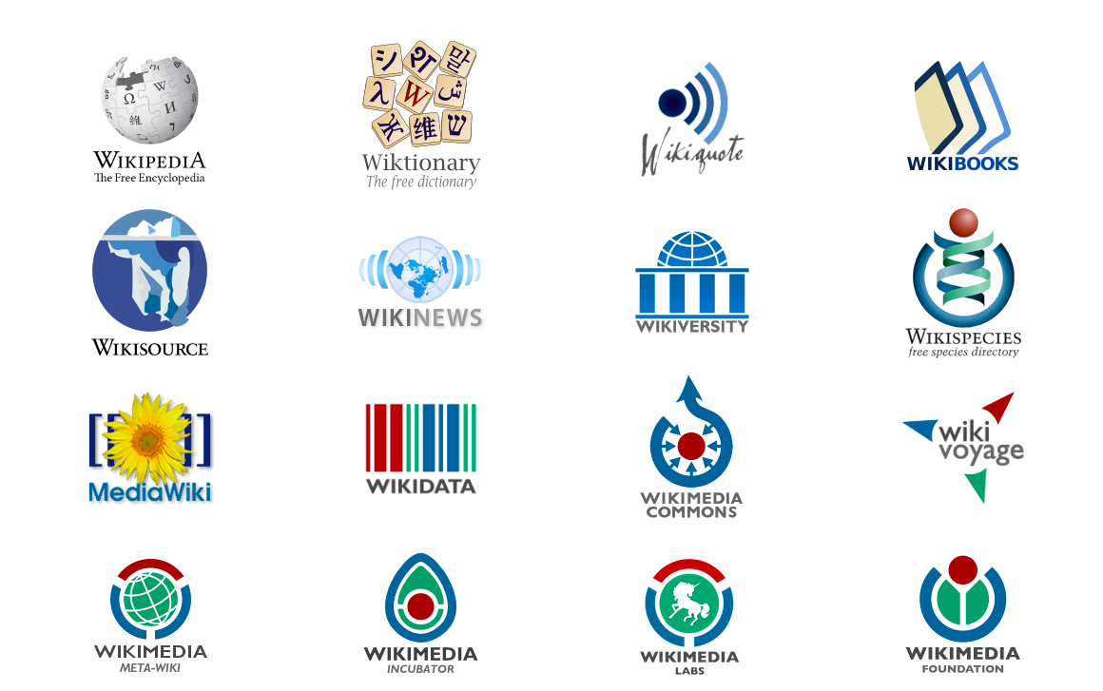

Slide 4
Movement Breakdown?
Affiliates
Developers
Editors

Slide 5
Why Africa Wikimedia Developers
There are very few developers from Africa in the Wikimedia Foundation (movement).
Volunteer developers to add more features on MediaWiki projects and its extensions including APIs etc.
Develop tools/projects that solve common problems within the African context to promote the movement’s activities in a technical approach.
Avoid waiting on a small skewed group of developers to solve the many tech problems in the movement especially peculiar problems pertaining to volunteers from our terrain.
Lack of participation from African volunteers in tech inclined Global events in the movement such as Google Summer of Code, Google Code-In, Outreach program for women etc...

Slide 6
Opportunities for Developers
Contribute to the mission of Wikipedia
Participate in an ecosystem that is diverse and constantly dynamic.
Learn new skills and develop professional skill sets
Leadership opportunities
Expand your networks/circles across the world.
Obtain results for work done and see the immediate impact on others.
Exposure (professional network, travel opportunities, mentors, internship, job opportunities, etc.)

Slide 7
Vision of Wikipedia
Imagine a world in which every single human being can freely share in the sum of all human knowledge. That's our commitment.

Slide 8
Next Steps……...
How do you become a part of the volunteering class who support this worthy cause.

